Slide 1
MINIMUM SPANNING TREES
SUBMITTED BY :- ABHISHEK LUTHRA
ROLL NO. :- 181210003

Slide 2
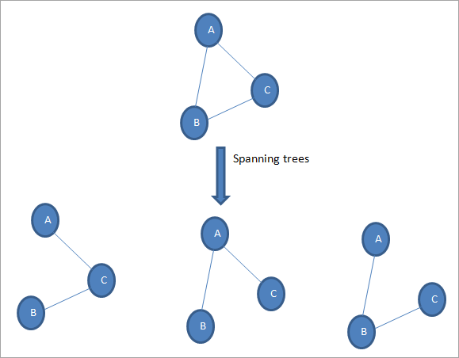
SPANNING TREE :-
Given an undirected and connected graph G=(V,E), a spanning tree of the graph G is a tree that spans G (that is, it includes every vertex of G) and is a subgraph of G (every edge in the tree belongs to G)

Slide 3
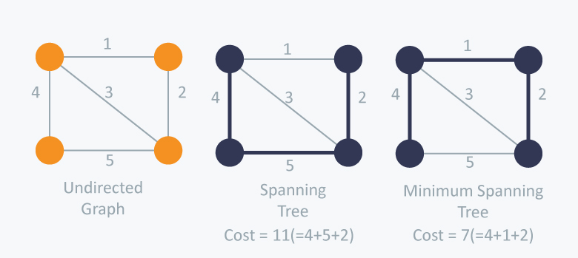
MINIMUM SPANNING TREE :-
The cost of the spanning tree is the sum of the weights of all the edges in the tree. There can be many spanning trees. Minimum spanning tree is the spanning tree where the cost is minimum among all the spanning trees.

Slide 4
METHODS TO FIND MINIMUM SPANNING TREE :-
There are two famous algorithms for finding the Minimum Spanning Tree: Prim’s Algorithm Kruskal’s Algorithm

Slide 5
PRIM’S ALGORITHM :-
Prim’s Algorithm also use Greedy approach to find the minimum spanning tree.
In Prim’s Algorithm we grow the spanning tree from a starting position. Unlike an edge in Kruskal's, we add vertex to the growing spanning tree in Prim's.

Slide 6
Algorithm Steps:
Maintain two disjoint sets of vertices. One containing vertices that are in the growing spanning tree and other that are not in the growing spanning tree.
Select the cheapest vertex that is connected to the growing spanning tree and is not in the growing spanning tree and add it into the growing spanning tree. This can be done using Priority Queues. Insert the vertices, that are connected to growing spanning tree, into the Priority Queue.
Check for cycles. To do that, mark the nodes which have been already selected and insert only those nodes in the Priority Queue that are not marked.

Slide 7
ALGORITHM:-
T = ∅;
U = { 1 };
while (U ≠ V)
let (u, v) be the lowest cost edge such that u ∈ U and v ∈ V - U;
T = T ∪ {(u, v)}
U = U ∪ {v}

Slide 8
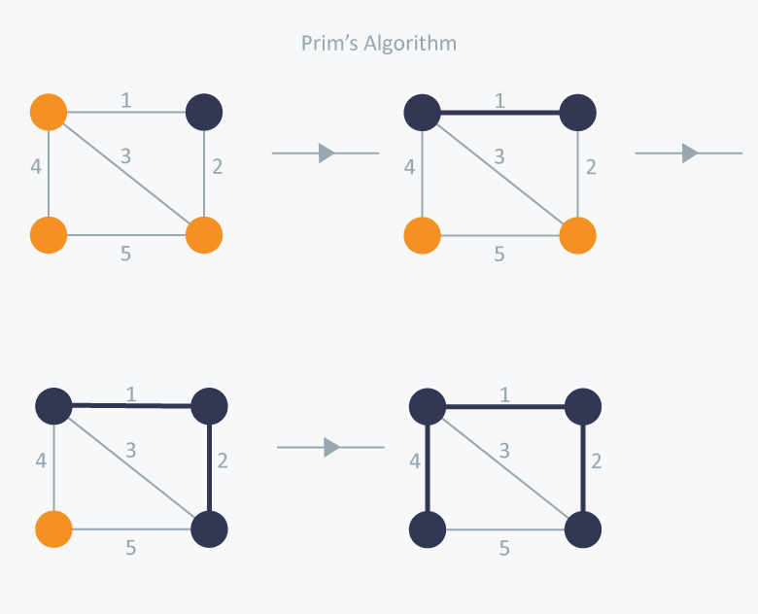
EXAMPLE :-

Slide 9
TIME COMPLEXITY :-
The time complexity of the Prim’s Algorithm is O((V+E)logV) because each vertex is inserted in the priority queue only once and insertion in priority queue take logarithmic time.

Slide 10
KRUSKAL’S ALGORITHM :-
Kruskal’s Algorithm builds the spanning tree by adding edges one by one into a growing spanning tree.
Kruskal's algorithm follows greedy approach as in each iteration it finds an edge which has least weight and add it to the growing spanning tree.

Slide 11
Algorithm Steps:
Sort the graph edges with respect to their weights.
Start adding edges to the MST from the edge with the smallest weight until the edge of the largest weight.
Only add edges which doesn't form a cycle , edges which connect only disconnected components.

Slide 12
ALGORITHM :-
KRUSKAL(G):
A = ∅
For each vertex v ∈ G.V:
MAKE-SET(v)
For each edge (u, v) ∈ G.E ordered by increasing order by weight(u, v):
if FIND-SET(u) ≠ FIND-SET(v):
A = A ∪ {(u, v)}
UNION(u, v)
return A

Slide 13
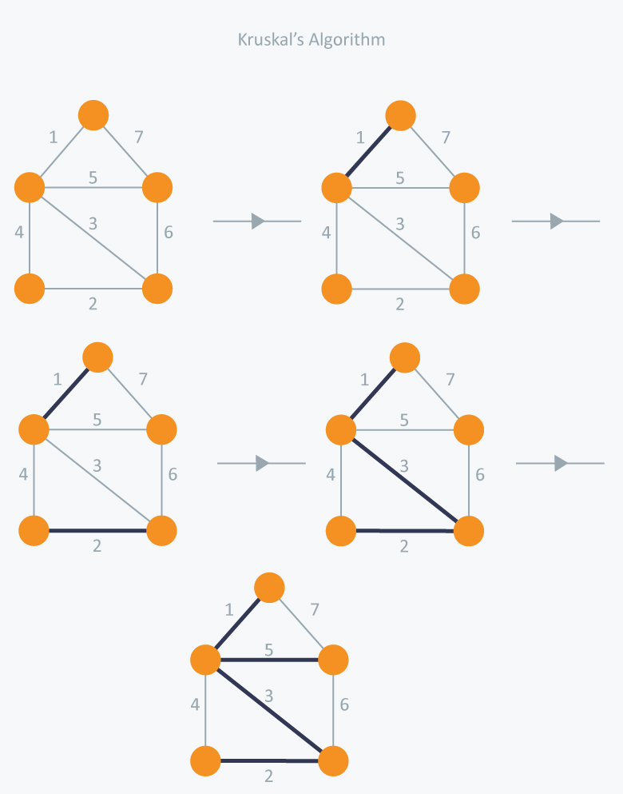
EXAMPLE :-

Slide 14
TIME COMPLEXITY :-
In Kruskal’s algorithm, most time consuming operation is sorting because the total complexity of the Disjoint-Set operations will be O(ElogV). which is the overall Time Complexity of the algorithm.

